Slide 1
S-GEMS Modeling spatial uncertainty
Modeling Uncertainty in the Earth Sciences

Slide 2
Download from coursework
SGEMSsimulation.zip (under “data” folder)

Slide 3
Spatial stochastic simulation
simulations
Seed 1
Seed 2
(input uncertainty)
Spatial
Stochastic
simulator
input
(spatial uncertainty)
Conditional simulation
= constrained to data
Unconditional simulation
= non constrained to any data
Data
(samples, well, geophysics…)

Slide 4
Principle of sequential simulation

Slide 5
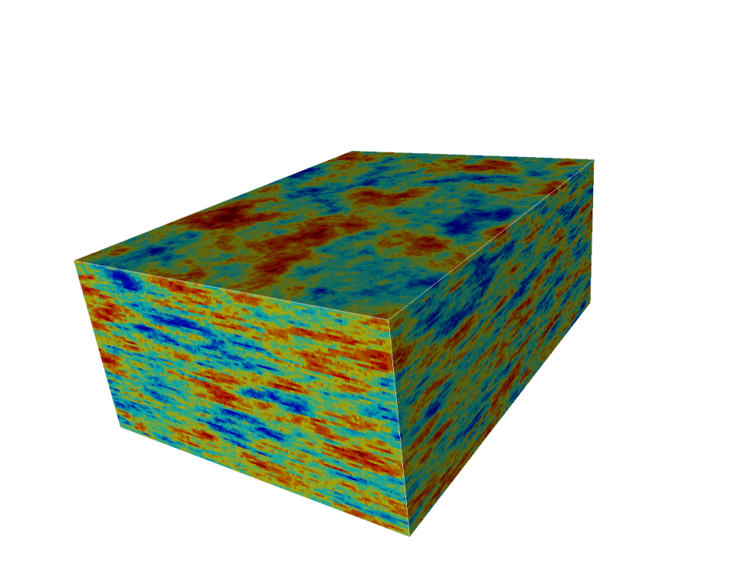
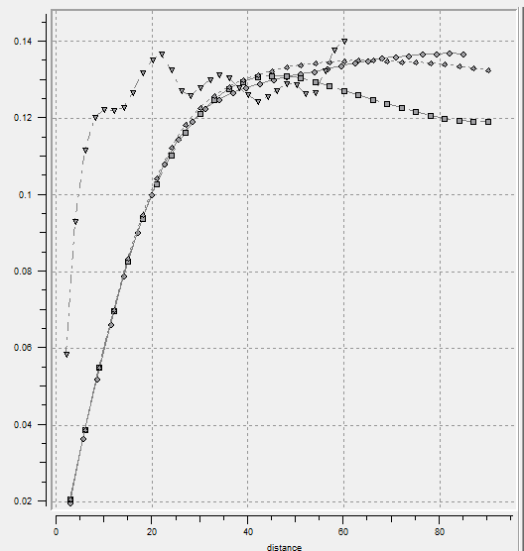
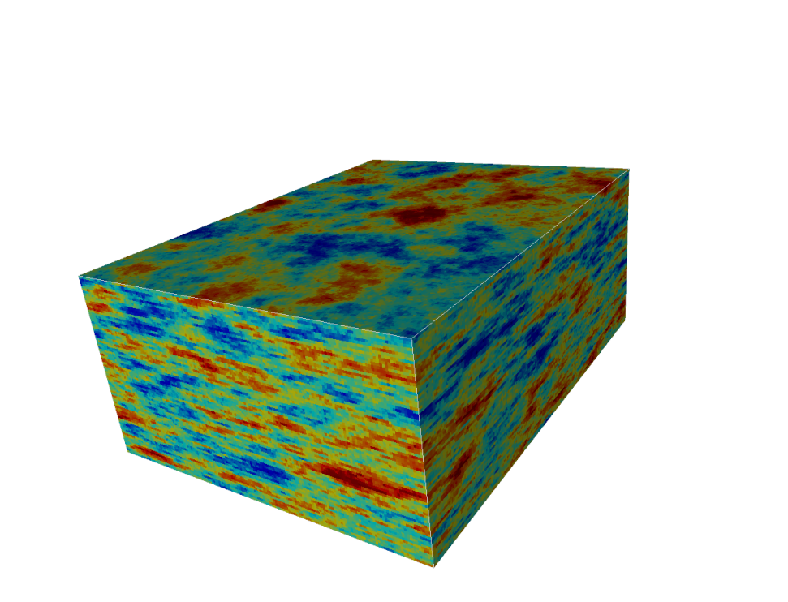
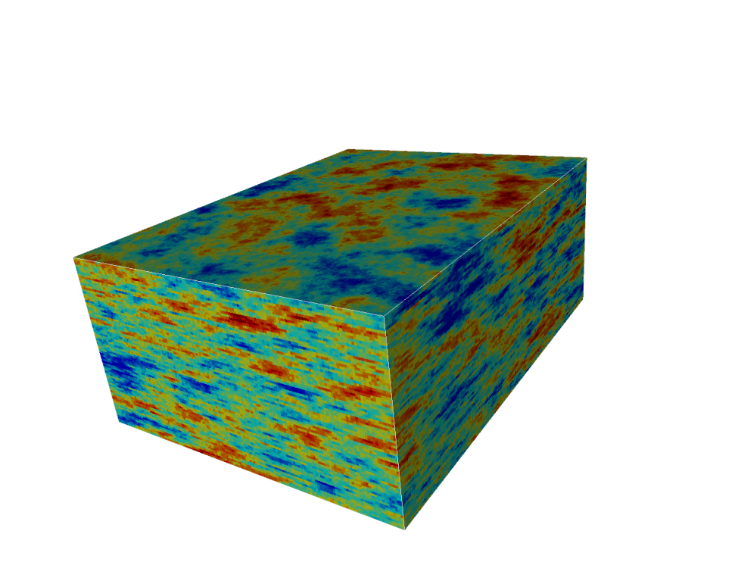
Variogram-based Earth models
and infinite more if you want

Slide 6
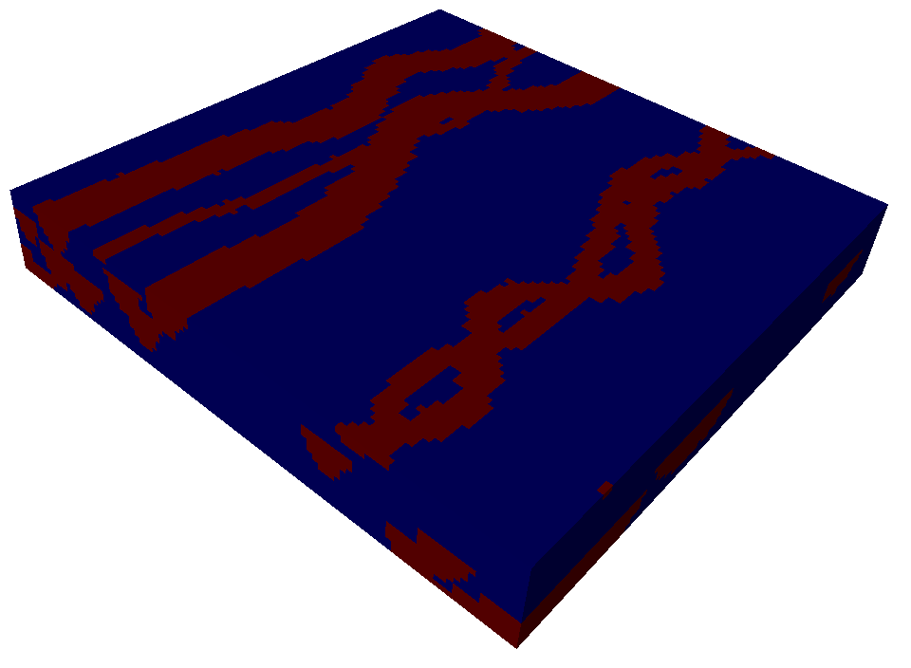
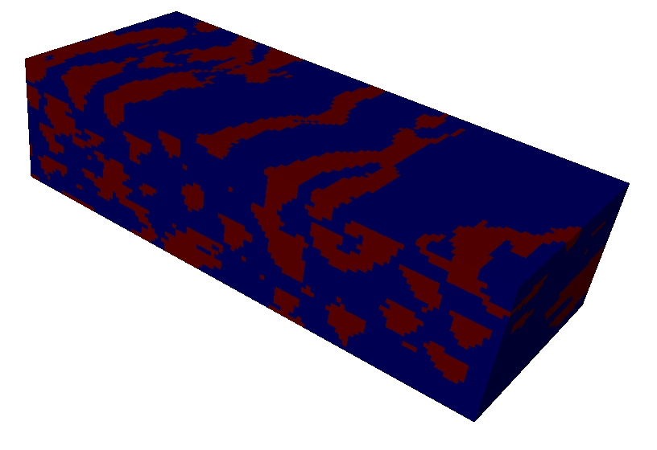

Training image-based Earth models
Training image
Earth models
and infinite more if you want

Slide 7
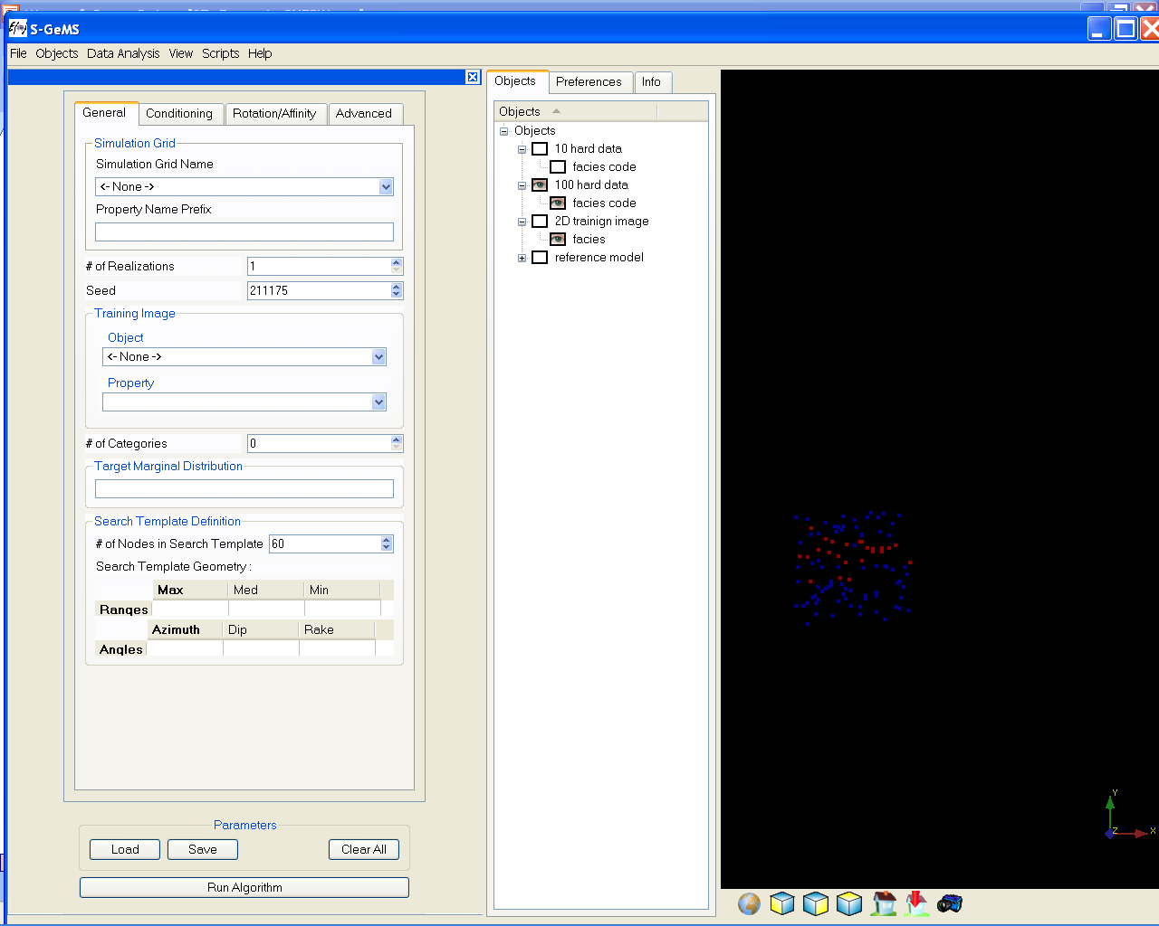
SNESIM in S-GEMS, tab 1: general
(1) Select the grid on which to simulate
(2) Give a property name
(3) Select the number of realizations to generate
(4) The random seed
(5) The object the training image
(6) The number of facies that you are simulating
(7) The number of nodes in the data template
important parameter:
this determines the accuracy of training
image pattern reproduction, but also the
amount of RAM you will be using
(8) The search neighborhood:
determines which nodes are included in the
as defined by those closest within a 3D ellipsoid
defined by the length of its major axis (3) and the
direction of these axis defined by three angles
(see rotation convention)
(1)
(2)
(3)
(4)
(5)
(6)
(7)
(8)

Slide 8
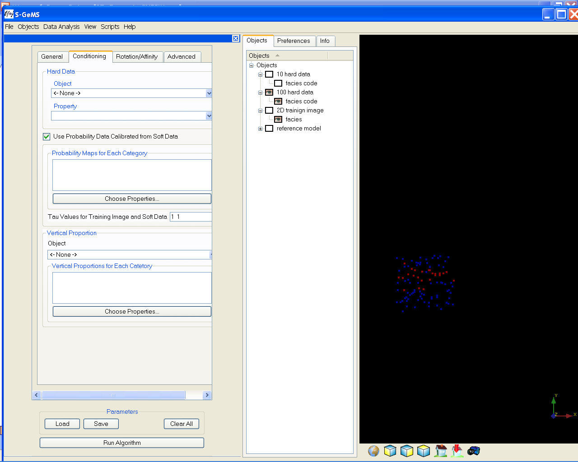
SNESIM in S-GEMS, tab 2: data
(9) Point set with hard data
(10) Probabilities derived from seismic, see next slide
(11) Vertical proportion curve
(9)
(10)
(11)

Slide 9
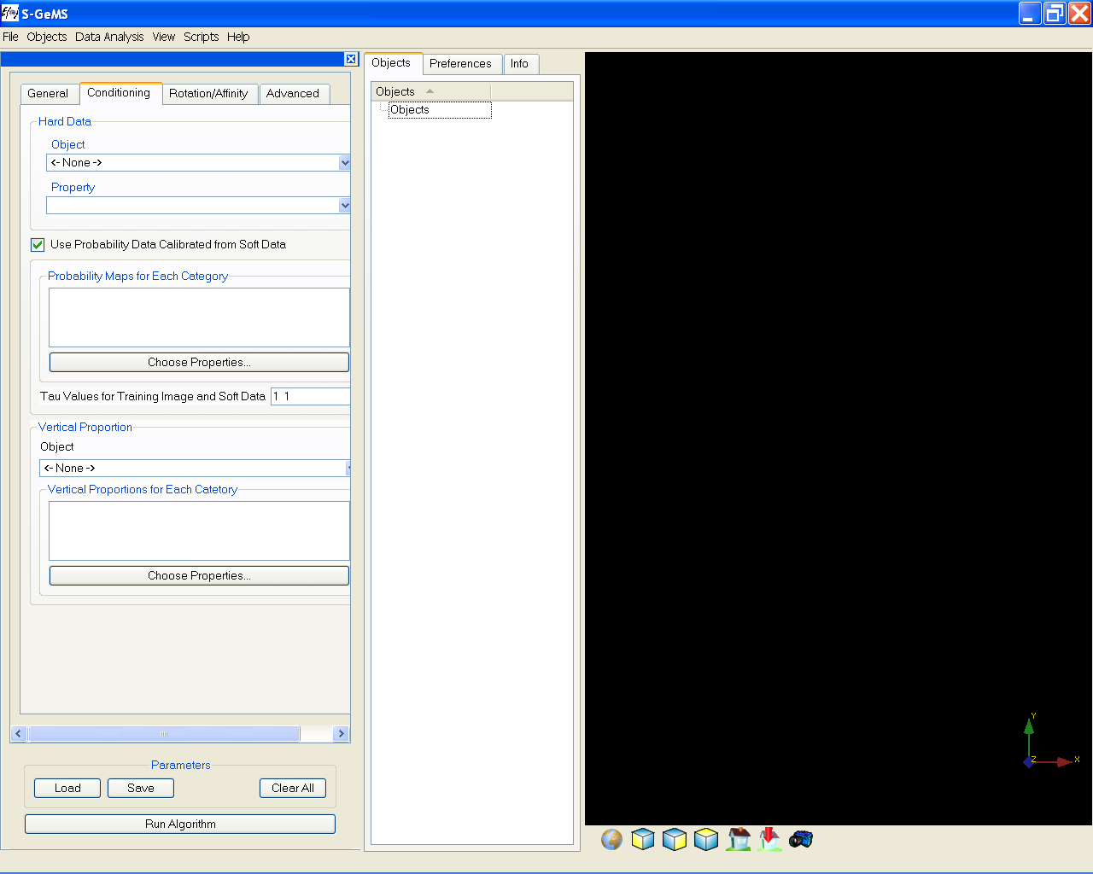
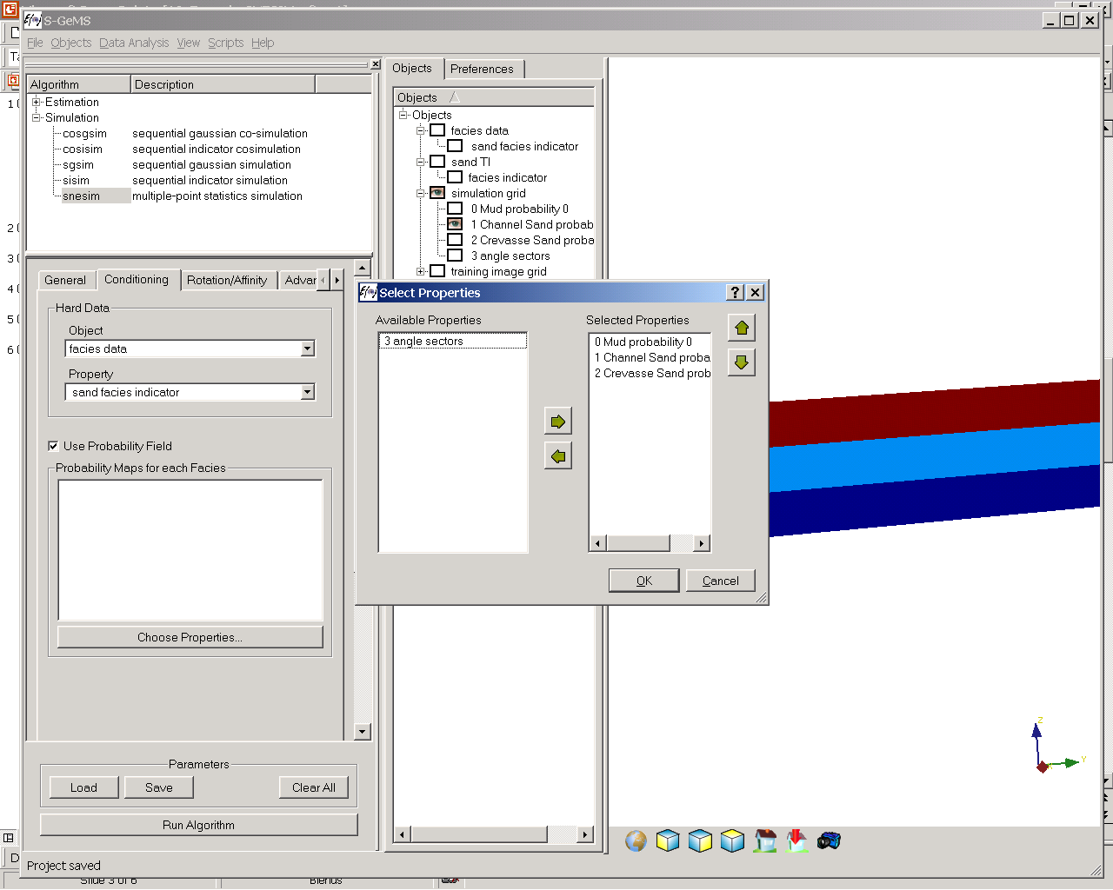
SNESIM in GEMS, tab 2: data
(1) Point set with hard data
(2) Probabilities derived from seismic,
Clicking the “choose property” tab allows you to select
A probability cube for each facies (you need one for each
facies defined)
(3) Tau values (default = 1)
(1)
(2)
(3)
Select properties using
the arrow tabs

Slide 10
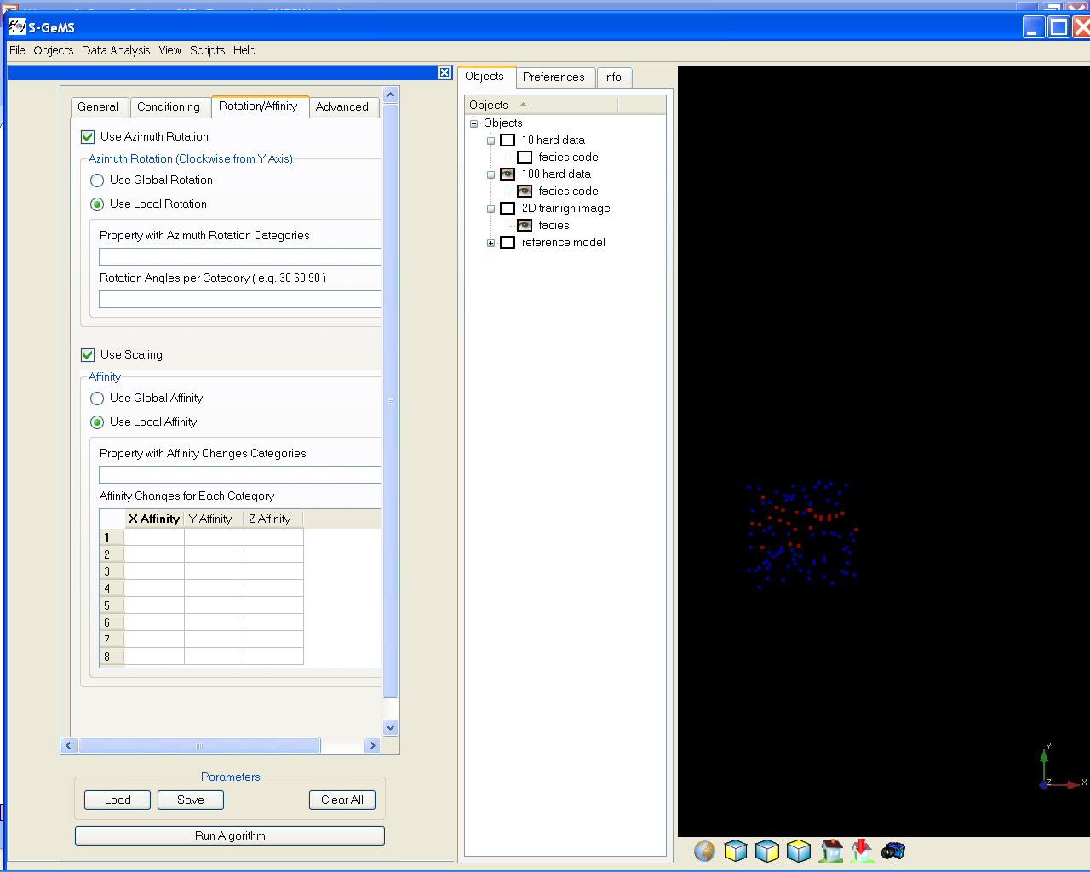
SNESIM in S-GEMS, tab 3: rotation
(12) The facies can be rotated globally or that rotation
can be varied locally
(13) If a local rotation is defined than a file needs to be
provided that divides the simulation grid in a number of
regions, numbered as 0,1,2,3…
Each region can then have a different rotation
angle as specified on the line below
(11)
(12)

Slide 11
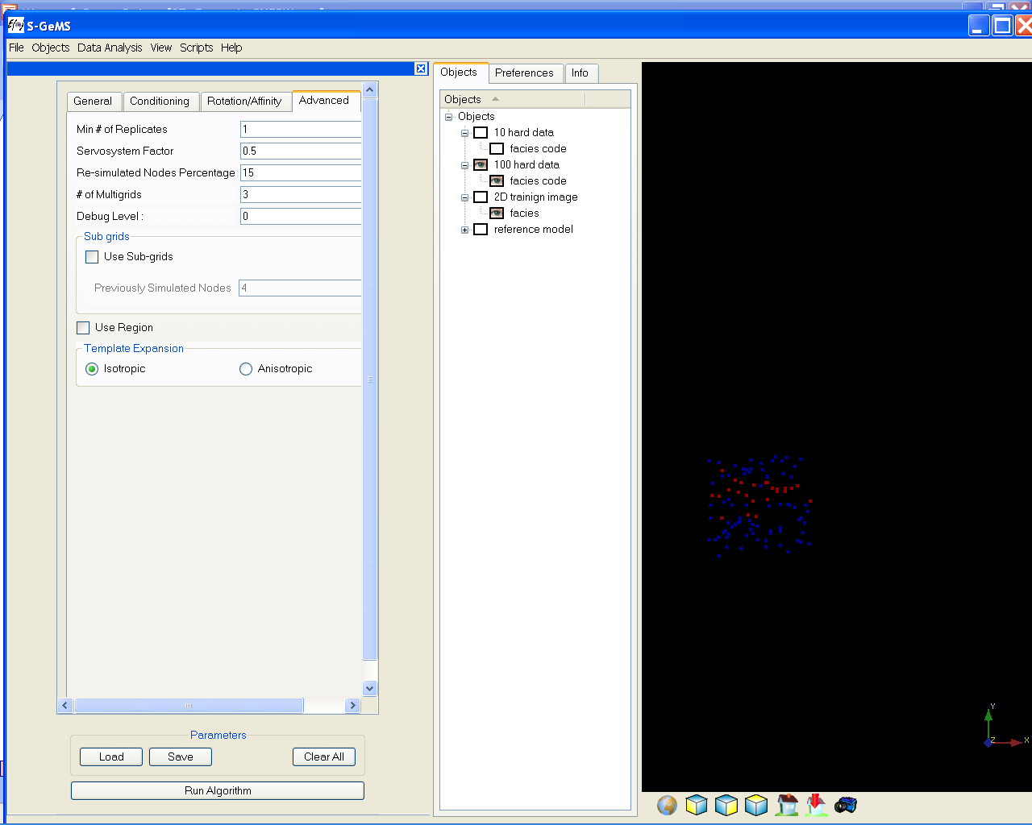
SNESIM in S-GEMS, tab 4: Advanced
(13)
(14)
(13) Minimum number of replicates required to calculate
conditional probabilities
(14) How much do you want to honor the
training image proportions
exactly: set to ‘1’
not at all: set to ‘0’
somewhat: set in between [0,1]
(15) Number of multiple grids used: typically 3 or 4
(16) this tuning parameters may slow the simulation
but generally improve the results
(17) Regions definition and simulation (not covered in this
course
(15)
(16)
(17)

Slide 12
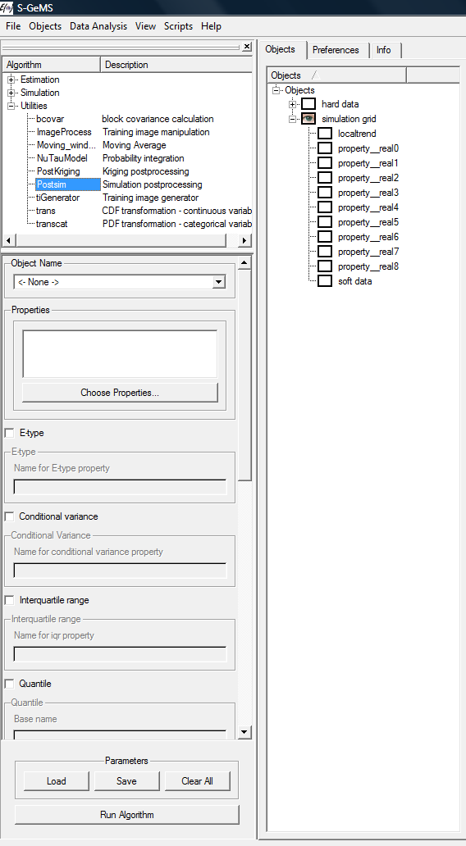
Calculating the ensemble average and other summary statistics from multiple Earth models
After having created several Earth models, the Utility “Postsim” allows one to calculate summary statistics of the ensemble of Earth models such as
Ensemble average (E-type)
Variance (variation between models)
IQR
Quartile
Probability below threshold

Slide 13
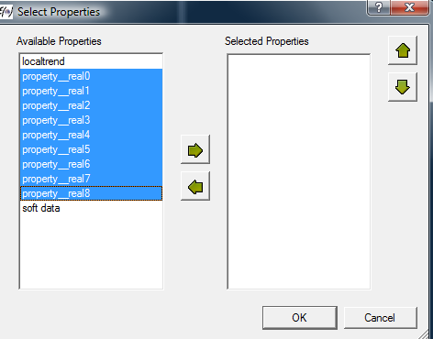
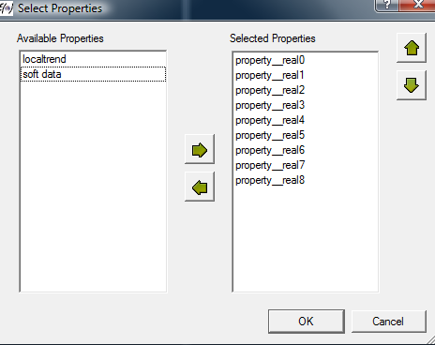
Summary statistics
Select the Earth models
Select the grid with the Earth model
Postsim will create a new property with the name you give

Slide 14
SNESIM exercise in 2D
Load the project 2DSNESIM.prj
Click on snesim_std in the algorithm window
Load the snesim2D.par file
Complete the parameters for the given training image
Create 20 unconditional simulations
Create 20 conditional simulations
Calculate an ensemble average for each set

Slide 15
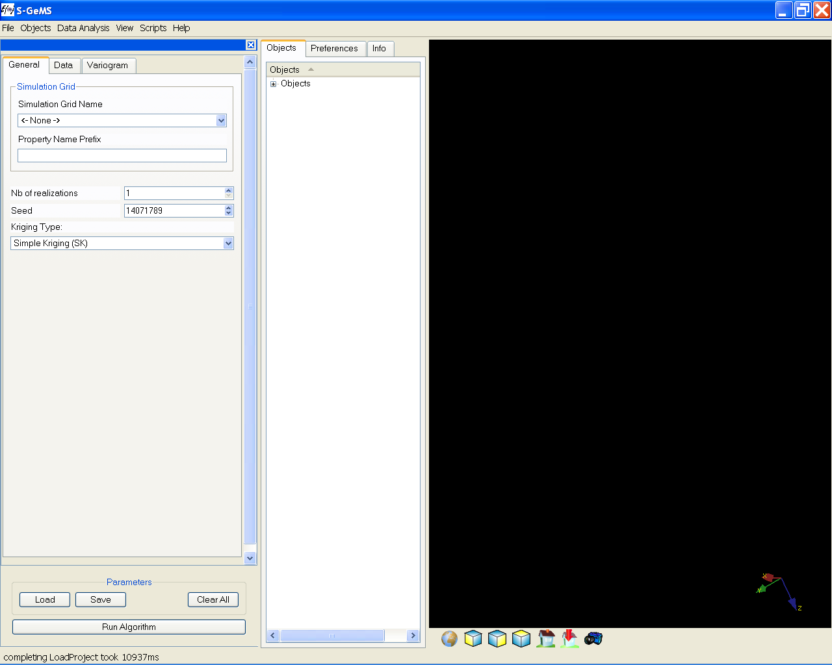
SGSIM in S-GEMS
(1) Select the grid on which to simulate
(2) Give a property name
(3) Select the number of realizations to generate
(4) The random seed
(5) The kriging Type
Simple Kriging
Ordinary Kriging
Kriging with Trend
Kriging with Locally Varying Mean
(1)
(2)
(3)
(4)
(5)

Slide 16
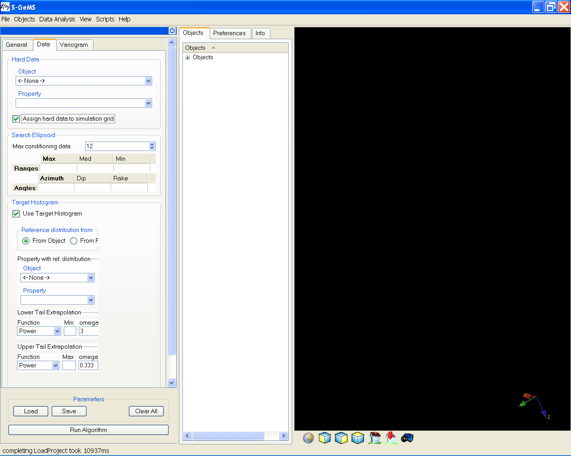
SGSIM in S-GEMS, cntd
(6) (7) The object containing hard data and the
property to condition to
(8) Data (wells) need not fall on the grid, you can
move data on the grid to speed up the simulation
! This is not desirable if your grid is very coarse
(9) In estimating the ccdf at each location you need
to specify a maximum number of data in order
to save CPU
(10) Such data are searched in an ellipsoid that
usually has the same anisotropy as the variogram
(11) Select the histogram, either from data or from a file
Next: specify the tail extrapolations
(6)
(7)
(8)
(9)
(10)
(11)

Slide 17
Tail extrapolation: recall
1/(n+1) to allow extrapolation
1
1/7
Linear inter/extrapolation
Non-linear inter/extrapolation
3.2
8.6
9.5
10.1
15.4
20.6
100
porosity
6 data samples: 3.2 / 8.6 / 9.5 / 10.1 / 15.4 / 20.6

Slide 18
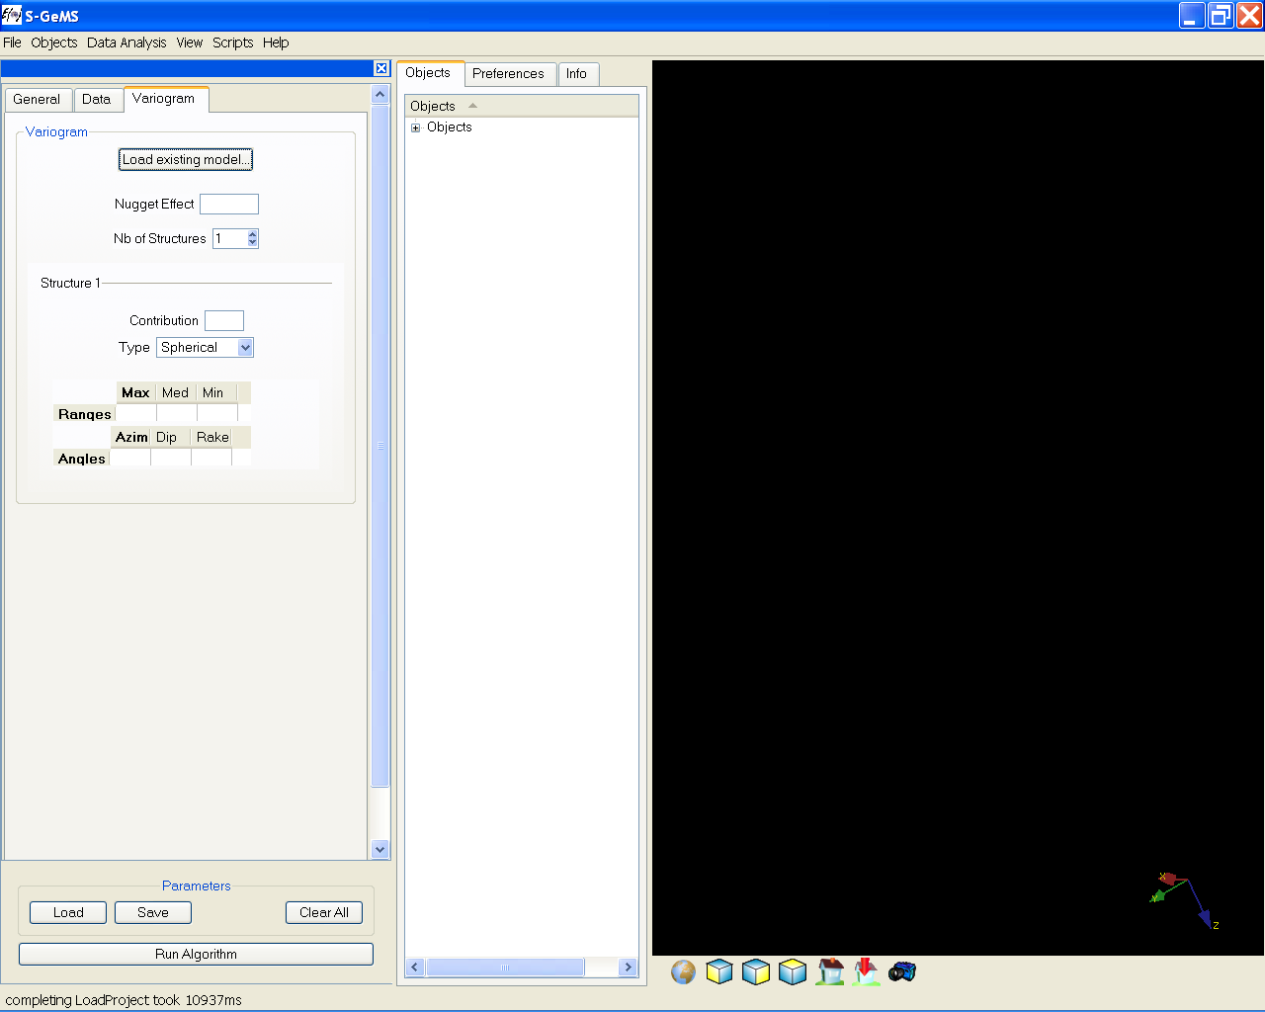
SGSIM in S-GEMS, cntd
Specify the variogram model, either
by loading the parameters saved during
variogram modeling
Inputting the variogram parameters
For this class we did not do any modeling, but we can use our interpretation to input the parameters as well
Nugget effect
Contribution = Sill – Nugget effect
However in SGSIM everything needs to be standardize to one
So if your nugget = 2 and the sill = 6, then you would enter
Nugget = 0.25, Contribution = 0.75

Slide 19
SGSIM in S-GEMS
In 3D you may have variation of the range with direction, this is called anisotropy
In most cases we have that the shortest range is in the vertical direction, the maximum is in the horizontal, the medium allows you to specify the shortest range in the horizontal
In most cases you will only need to specify the azimuth because we already know that the shortest range in along the vertical (so dip=0, rake=0)

Slide 20
SGSIM exercise in 2D
Load the project 2DSGSIM.prj
Click on sgsim in the algorithm window
Load the sgsim2D.par file
Complete the parameters for a variogram with
no nugget
contribution = 1
Major range = 20, Minor = 10, azm = 45
Create 20 unconditional simulations
Create 20 conditional simulations
Calculate ensemble averages

Slide 21
SGSIM Exercise in 2D
Study the following changes (just create one model each time)
Change the variogram to Gaussian
Change the ranges
Change the azm angle

